Slide 1
AORTIC ANEURYSM

Slide 2
Aortic Aneurysms
Definition
Outpouchings or dilations of the arterial wall
Common problems involving aorta
Occur in men more often than in women
Incidence ↑ with age

Slide 3
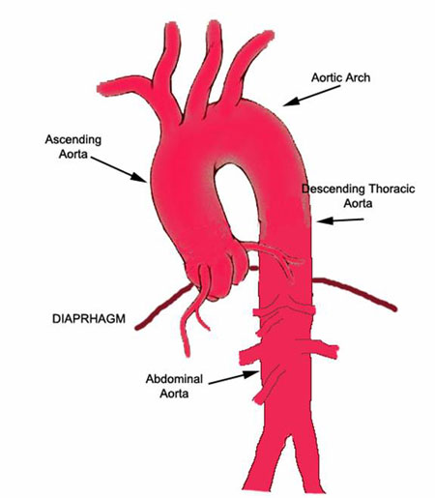
Clinical Manifestations Aortic Aneurysm
Ascending aorta/aortic arch
Produce angina
Hoarseness
If presses on superior vena cava
Decreased venous return can cause
Distended neck veins
Edema of head and arms

Slide 4
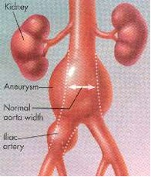
Clinical Manifestations Aortic Aneurysm
Abdominal aortic aneurysms (AAA)
Often asymptomatic
Frequently detected
On physical exam
Pulsatile mass in periumbilical area
Bruit may be auscultated
When patient examined for unrelated problem (i.e., CT scan, abdominal x-ray)

Slide 5
Clinical Manifestations Aortic Aneurysm
Abdominal Aortic Aneurysms (AAA), (con’t)
May mimic pain associated with abdominal or back disorders
May spontaneously embolize plaque
Causing “blue toe syndrome”
patchy mottling of feet/toes with presence of palpable pedal pulses

Slide 6
Aortic Aneurysm Complications
Rupture- serious complication related to untreated aneurysm
Posterior rupture
Bleeding may be tamponaded by surrounding structures, thus preventing exsanguination and death
Severe pain
May/may not have back/flank ecchymosis
Anterior rupture
Massive hemorrhage
Most do not survive long enough to get to the hospital

Slide 7
Aortic Aneurysm Collaborative Care
Goal - prevent aneurysm from rupturing
Early detection/treatment imperative
Once detected
Studies done to determine size and location

Slide 8
Aortic Aneurysm Nursing Management
Nursing Assessment
Thorough history and physical exam
Watch for signs of cardiac, pulmonary, cerebral, lower extremity vascular problems
Establish baseline data to compare postoperatively
Note quality and character of peripheral pulses and neurologic status
Mark/document pedal pulse sites and any skin lesions on lower extremities before surgery

Slide 9
Aortic Aneurysm Nursing Management
Nursing Assessment
Monitor for indications of rupture
Diaphoresis
Paleness
Weakness
Tachycardia
Abdominal, back, groin or periumbilical pain
Changes in level of consciousness
Pulsating abdominal mass

Slide 10
Aortic Aneurysm Nursing Management
Planning
Overall goals include
Normal tissue perfusion
Intact motor and sensory function
No complications related to surgical repair

Slide 11
Aortic Aneurysm Nursing Management
Health Promotion
Alert for opportunities to teach health promotion to patients and their families
Encourage patient to reduce cardiovascular risk factors
These measure help ensure graft patency after surgery

Slide 12
Aortic Aneurysm Nursing Management
Acute Intervention
Patient/family teaching
Providing support for patient/family
Careful assessment of all body systems
Pre-op teaching
Brief explanation of disease process
Planned surgical procedure
Pre-op routines (scheduled)
Bowel prep, NPO, shower
Pre-op (emergent)
Fluids
Expectations after surgery
Recovery room, tubes, drains
ICU

Slide 13
Aortic Aneurysm Nursing Management
Acute Intervention (cont’d)
Postop
Maintain graft patency
Normal blood pressure
CVP or PA pressure monitoring
Urinary output monitoring
Avoid severe hypertension
Cardiovascular status
Continuous ECG monitoring
Electrolyte monitoring
Arterial blood gas monitoring
Oxygen administration

Slide 14
Aortic Aneurysm Nursing Management
Acute Intervention (cont’d)
Infection
Antibiotic administration
Assessment of body temperature
Monitoring of WBC
Adequate nutrition
Observe surgical incision for signs of infection
Gastrointestinal status
Nasogastric tube
Abdominal assessment
Passing of flatus is key sign of returning bowel function
Watch for manifestations of bowel ischemia

Slide 15
Aortic Aneurysm Nursing Management
Acute Intervention (cont’d)
Neurologic status
Level of consciousness
Pupil size and response to light
Facial symmetry
Speech
Ability to move upper extremities
Quality of hand grasps
Peripheral perfusion status
Pulse assessment
Mark pulse locations with felt-tip pen
Extremity assessment
Temperature, color, capillary refill time, sensation and movement of extremities

Slide 16
Aortic Aneurysm Nursing Management
Acute Intervention (cont’d)
Renal perfusion status
Urinary output
Fluid intake
Daily weight
CVP/PA pressure
Blood urea nitrogen/Creatinine

Slide 17
Aortic Aneurysm Nursing Management
Ambulatory and Home Care
Encourage patient to express concerns
Patient instructed to gradually increase activities
No heavy lifting
Educate on signs and symptoms of complications
Infection
Neurovascular changes

Slide 18
Aortic Aneurysm Nursing Management
Evaluation
Expected Outcomes
Patent arterial graft with adequate distal perfusion
Adequate urine output
Normal body temperature
No signs of infection

Slide 19
AORTIC DISSECTION

Slide 20
aortic Dissection
Not a type of aneurysm
Result of a tear in the intimal (innermost)lining of the arterial wall
Men>women
Acute and life-threatening
Mortality rate 90% if acute dissection and not treated surgically

Slide 21
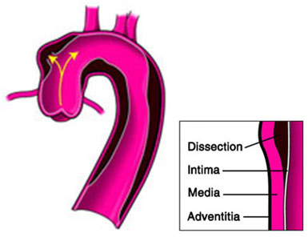
Aortic dissection
Tear in intimal lining allows blood to track between the intima and media, creating a false lumen of blood flow
With heart contraction, increased pressure on damaged area results in further dissection
Retrieved from http://aorticclinic.com/images/aortic-dissection.jpg

Slide 22
Clinical Manifestations: Aortic dissection
Sudden, severe, pain in anterior chest
Radiation down spine into abdomen and legs
“tearing” or “ripping”
Mimics MI
If involves aortic arch:
Neuro deficiencies (decreased LOC, dizziness)

Slide 23
Complications: Aortic dissection
Cardiac tamponade
Blood escapes from dissection into pericardial sac
Hypotension, distended neck veins, muffled heart sounds
Rupture
May lead to hemorrhage in mediastinal, pleural, or abdominal cavity
Results in death
Occlusion of supply to vital organs
Spinal cord, kidneys, and abdominal organs

Slide 24
Diagnostic studies
Chest x-ray
EEG
Rule out MI
MRI
Diagnostic procedure of choice
Assists in determining severity of dissection
Echocardiogram
Left ventricular hypertrophy

Slide 25
Collaborative Care
Lower the BP
Sodium nitroprusside (Nipride)
Calcium channel blockers
ACE inhibitors
Decrease myocardial contractility
Β- blockers
Esmolol (Brevibloc)
Rapid onset and short ½ life

Slide 26
Collaborative care
Treat conservatively
If no symptoms and complications
Pain relief
Blood transfusion
Management of heart failure
Surgical Therapy
If ineffective drug therapy of complications of aortic dissection are present
30-day mortality of acute aortic dissections is 10 – 28%
MI, cerebral ischemia, uncontrolled bleeding, abdominal ischemia, sepsis, multiorgan failure

Slide 27
Nursing management
Preoperatively
Semi-Fowler position
Quiet environment
Pain medications
IV administration of antihypertensive drug
Continuous ECG monitoring
Assess for changes in CMS
Frequent VS
Discharge teaching
Antihypertensive drugs
SE, action, drug regimen
Follow-up and reoccurrence of symptoms

